Slide 1

Analysis of Algorithms
CS 477/677
Minimum Spanning Trees (MST)
Instructor: George Bebis
Chapter 23

Slide 2
Minimum Spanning Trees
Spanning Tree
  A tree (i.e., connected, acyclic graph) which contains all the vertices of the graph
Minimum Spanning Tree
  Spanning tree with the minimum sum of weights
Spanning forest
  If a graph is not connected, then there is a spanning tree for each connected component of the graph
b
8
c
7
d
4
9
2
a
11
i
4
14
e
8
7
6
10
g
g
f
1
2

Slide 3
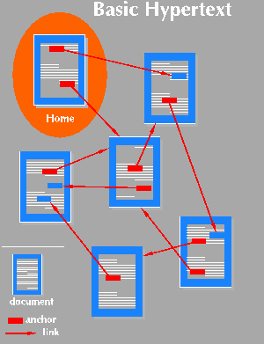

Applications of MST
  Find the least expensive way to connect a set of cities, terminals, computers, etc.

Slide 4

Example
8
7
Problem
A town has a set of houses
and a set of roads
A road connects 2 and only
2 houses
A road connecting houses u and v has a repair
cost w(u, v)
Goal: Repair enough (and no more) roads such that:
Everyone stays connected
  i.e., can reach every house from all other houses
2. Total repair cost is minimum
b
c
d
4
9
2
a
11
i
4
14
e
8
7
6
10
h
g
f
1
2

Slide 5
Minimum Spanning Trees
A connected, undirected graph:
  Vertices = houses, Edges = roads
A weight w(u, v) on each edge (u, v) ∈ E
Find T ⊆ E such that:
T connects all vertices
w(T) = Σ_{(u,v)∈T} w(u, v) is
minimized
b
8
c
7
d
4
9
2
a
11
i
4
14
e
8
7
6
10
h
g
f
1
2

Slide 6
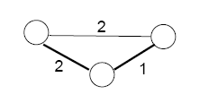
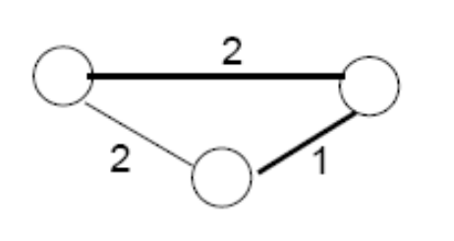
Properties of Minimum Spanning Trees
Minimum spanning tree is not unique
MST has no cycles – see why:
  We can take out an edge of a cycle, and still have the vertices connected while reducing the cost
# of edges in a MST:
  |V| - 1

Slide 7
Growing a MST – Generic Approach
Grow a set A of edges (initially empty)
Incrementally add edges to A such that they would belong
to a MST
  An edge (u, v) is safe for A if and only if A ∪ {(u, v)} is also a subset of some MST
b
8
c
7
d
4
9
2
a
11
i
4
14
e
8
7
6
10
Idea: add only “safe” edges
h
g
f
1
2

Slide 8
Generic MST algorithm
A ← ∅
while A is not a spanning tree
do find an edge (u, v) that is safe for A
A ← A ∪ {(u, v)}
return A
How do we find safe edges?
b
8
c
7
d
4
9
2
a
11
i
4
14
e
8
7
6
10
h
g
f
1
2

Slide 9
Finding Safe Edges
b
8
c
7
d
V - S
Let’s look at edge (h, g)
  Is it safe for A initially?
Later on:
  Let S ⊂ V be any set of vertices that includes h but not g (so that g is in V - S)
  In any MST, there has to be one edge (at least) that connects S with V - S
  Why not choose the edge with minimum weight (h,g)?
4
9
2
a
11
i
4
14
e
8
7
6
10
S
h
g
f
1
2

Slide 10
Definitions
8
7
A cut (S, V - S)
is a partition of vertices
into disjoint sets S and V - S
An edge crosses the cut
(S, V - S) if one endpoint is in S
and the other in V – S
b
c
d
4
9
2
S
a
11
i
4
14
e
S
V- S 
8
7
6
10
 V- S
h
g
f
1
2

Slide 11
Definitions (cont’d)
8
7
A cut respects a set A
of edges ⇔ no edge
in A crosses the cut
An edge is a light edge
crossing a cut ⇔ its weight is minimum over all edges crossing the cut
  Note that for a given cut, there can be > 1 light
  edges crossing it
b
c
d
4
9
2
S
a
11
i
4
14
e
S
V- S 
8
7
6
10
 V- S
h
g
f
1
2

Slide 12
Theorem
Let A be a subset of some MST (i.e., T), (S, V - S) be a cut that respects A, and (u, v) be a light edge crossing (S, V-S). Then (u, v) is safe for A .
Proof:
Let T be an MST that includes A
  edges in A are shaded
Case1: If T includes (u,v), then
it would be safe for A
Case2: Suppose T does not include
the edge (u, v)
Idea: construct another MST T’
that includes A ∪ {(u, v)}
S
u
v
V - S

Slide 13
Theorem - Proof
T contains a unique path p between u and v
Path p must cross the
cut (S, V - S) at least
once: let (x, y) be that edge
Let’s remove (x,y) ⇒ breaks
T into two components.
Adding (u, v) reconnects the components
T’ = T - {(x, y)} ∪ {(u, v)}
S
x
u
y
p
v
V - S

Slide 14
Theorem – Proof (cont.)
T’ = T - {(x, y)} ∪ {(u, v)}
Have to show that T’ is an MST:
(u, v) is a light edge
⇒ w(u, v) ≤ w(x, y)
w(T ’) = w(T) - w(x, y) + w(u, v)
≤ w(T)
Since T is a spanning tree
w(T) ≤ w(T ’) ⇒ T’ must be an MST as well
S
x
u
y
p
v
V - S

Slide 15
Theorem – Proof (cont.)
Need to show that (u, v) is safe for A:
i.e., (u, v) can be a part of an MST
A ⊆ T and (x, y) ∉ T ⇒
(x, y) ∉ A ⇒ A ⊆T’
A ∪ {(u, v)} ⊆ T’
Since T’ is an MST
⇒ (u, v) is safe for A
S
x
u
y
p
v
V - S

Slide 16
Prim’s Algorithm
The edges in set A always form a single tree
Starts from an arbitrary “root”: V_{A} = {a}
At each step:
  Find a light edge crossing (V_{A}, V - V_{A})
  Add this edge to A
  Repeat until the tree spans all vertices
b
8
c
7
d
4
9
2
a
11
i
4
14
e
8
7
6
10
h
g
f
1
2

Slide 17
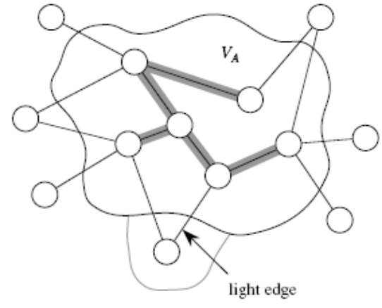
How to Find Light Edges Quickly?
Use a priority queue Q:
Contains vertices not yet
included in the tree, i.e., (V – V_{A})
  V_{A} = {a}, Q = {b, c, d, e, f, g, h, i}
We associate a key with each vertex v:
key[v] = minimum weight of any edge (u, v) connecting v to V_{A}
b
8
c
7
d
4
9
2
a
11
i
4
14
e
8
7
6
10
h
g
f
1
2
Key[a]=min(w₁,w₂)
w₁
a
w₂

Slide 18
How to Find Light Edges Quickly? (cont.)
After adding a new node to V_{A} we update the weights of all the nodes adjacent to it
  e.g., after adding a to the tree, k[b]=4 and k[h]=8
Key of v is ∞ if v is not adjacent to any vertices in V_{A}
b
8
c
7
d
4
9
2
a
11
i
4
14
e
8
7
6
10
h
g
f
1
2

Slide 19
Example
∞
∞
∞
b
8
c
7
d
0 ∞ ∞ ∞ ∞ ∞ ∞ ∞ ∞
Q = {a, b, c, d, e, f, g, h, i}
V_{A} = ∅
Extract-MIN(Q) ⇒ a
4
9
∞
2
∞
a
11
i
4
14
e
8
7
6
10
h
g
f
1
2
∞
∞
∞
4
∞
∞
∞
key [b] = 4 π [b] = a
key [h] = 8 π [h] = a
4 ∞ ∞ ∞ ∞ ∞ 8 ∞
Q = {b, c, d, e, f, g, h, i} V_{A} = {a}
Extract-MIN(Q) ⇒ b
b
8
c
7
d
4
9
∞
2
∞
a
11
i
4
14
e
8
7
6
10
h
g
f
1
2
∞
∞
∞
8

Slide 20
Example
8
key [c] = 8 π [c] = b
key [h] = 8 π [h] = a - unchanged
8 ∞ ∞ ∞ ∞ 8 ∞
Q = {c, d, e, f, g, h, i} V_{A} = {a, b}
Extract-MIN(Q) ⇒ c
4
∞
∞
b
8
c
7
d
4
9
∞
2
∞
a
11
i
4
14
e
8
7
6
10
h
g
f
1
2
∞
8
∞
key [d] = 7 π [d] = c
key [f] = 4 π [f] = c
key [i] = 2 π [i] = c
7 ∞ 4 ∞ 8 2
Q = {d, e, f, g, h, i} V_{A} = {a, b, c}
Extract-MIN(Q) ⇒ i
8
7
4
∞
b
8
c
7
d
4
2
9
∞
2
∞
a
11
i
4
14
e
8
7
6
10
h
g
f
1
2
8
∞
∞
4

Slide 21
Example
4
8
7
key [h] = 7 π [h] = i
key [g] = 6 π [g] = i
7 ∞ 4 6 8
Q = {d, e, f, g, h} V_{A} = {a, b, c, i}
Extract-MIN(Q) ⇒ f
b
8
c
7
d
4
9
2
2
∞
a
11
i
4
14
e
8
7
6
10
h
g
f
1
2
8
∞
4
7
6
4
8
7
key [g] = 2 π [g] = f
key [d] = 7 π [d] = c unchanged
key [e] = 10 π [e] = f
7 10 2 8
Q = {d, e, g, h} V_{A} = {a, b, c, i, f}
Extract-MIN(Q) ⇒ g
b
8
c
7
d
4
9
10
2
2
∞
a
11
i
4
14
e
8
7
6
10
h
g
f
1
2
7
6
4
2

Slide 22
Example
4
8
7
key [h] = 1 π [h] = g
7 10 1
Q = {d, e, h} V_{A} = {a, b, c, i, f, g}
Extract-MIN(Q) ⇒ h
b
8
c
7
d
4
9
10
2
2
a
11
i
4
14
e
8
7
6
10
h
g
f
1
2
7
2
4
7 10
Q = {d, e} V_{A} = {a, b, c, i, f, g, h}
Extract-MIN(Q) ⇒ d
1
4
8
7
b
8
c
7
d
4
9
10
2
2
a
11
i
4
14
e
8
7
6
10
h
g
f
1
2
1
2
4

Slide 23
Example
4
8
7
b
8
c
7
d
key [e] = 9 π [e] = f
9
Q = {e} V_{A} = {a, b, c, i, f, g, h, d}
Extract-MIN(Q) ⇒ e
Q = ∅ V_{A} = {a, b, c, i, f, g, h, d, e}
4
9
9
2
2
10
a
11
i
4
14
e
8
7
6
10
h
g
f
1
2
1
2
4

Slide 24
PRIM(V, E, w, r)
Q ← ∅
for each u ∈ V
do key[u] ← ∞
π[u] ← NIL
INSERT(Q, u)
DECREASE-KEY(Q, r, 0) ► key[r] ← 0
while Q ≠ ∅
do u ← EXTRACT-MIN(Q)
for each v ∈ Adj[u]
do if v ∈ Q and w(u, v) < key[v]
then π[v] ← u
DECREASE-KEY(Q, v, w(u, v))
Total time: O(VlgV + ElgV) = O(ElgV)
O(V) if Q is implemented as a min-heap
O(lgV)
Min-heap operations:
O(VlgV)
Executed |V| times
Takes O(lgV)
Executed O(E) times total
Constant
O(ElgV)
Takes O(lgV)

Slide 25
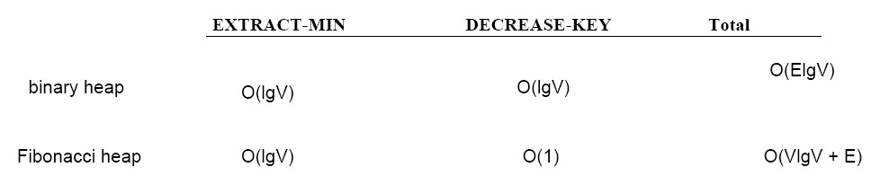
Using Fibonacci Heaps
Depending on the heap implementation, running time
could be improved!

Slide 26
Prim’s Algorithm
Prim’s algorithm is a “greedy” algorithm
  Greedy algorithms find solutions based on a sequence of choices which are “locally” optimal at each step.
Nevertheless, Prim’s greedy strategy produces a globally optimum solution!
  See proof for generic approach (i.e., slides 12-15)

Slide 27
A different instance of the generic approach
S
(instance 1)
(instance 2)
u
tree1
v
V - S
A is a forest containing connected components
  Initially, each component is a single vertex
Any safe edge merges two of these components into one
  Each component is a tree
u
v
tree2

Slide 28
Kruskal’s Algorithm
How is it different from Prim’s algorithm?
  Prim’s algorithm grows one
  tree all the time
  Kruskal’s algorithm grows
  multiple trees (i.e., a forest)
  at the same time.
  Trees are merged together
  using safe edges
  Since an MST has exactly |V| - 1
  edges, after |V| - 1 merges,
  we would have only one component
tree1
u
v
tree2

Slide 29
Kruskal’s Algorithm
Start with each vertex being its own component
Repeatedly merge two components into one by choosing the light edge that connects them
Which components to consider at each iteration?
  Scan the set of edges in monotonically increasing order by weight
b
8
c
7
d
4
9
2
a
11
i
4
14
e
8
7
6
10
h
g
f
1
2
We would add
edge (c, f)

Slide 30
Example
Add (h, g)
Add (c, i)
Add (g, f)
Add (a, b)
Add (c, f)
Ignore (i, g)
Add (c, d)
Ignore (i, h)
Add (a, h)
Ignore (b, c)
Add (d, e)
Ignore (e, f)
Ignore (b, h)
Ignore (d, f)
{g, h}, {a}, {b}, {c}, {d}, {e}, {f}, {i}
{g, h}, {c, i}, {a}, {b}, {d}, {e}, {f}
{g, h, f}, {c, i}, {a}, {b}, {d}, {e}
{g, h, f}, {c, i}, {a, b}, {d}, {e}
{g, h, f, c, i}, {a, b}, {d}, {e}
{g, h, f, c, i}, {a, b}, {d}, {e}
{g, h, f, c, i, d}, {a, b}, {e}
{g, h, f, c, i, d}, {a, b}, {e}
{g, h, f, c, i, d, a, b}, {e}
{g, h, f, c, i, d, a, b}, {e}
{g, h, f, c, i, d, a, b, e}
{g, h, f, c, i, d, a, b, e}
{g, h, f, c, i, d, a, b, e}
{g, h, f, c, i, d, a, b, e}
b
8
c
7
d
4
9
2
a
11
i
4
14
e
8
7
6
10
h
g
f
1
2
1: (h, g)
2: (c, i), (g, f)
4: (a, b), (c, f)
6: (i, g)
7: (c, d), (i, h)
8: (a, h), (b, c)
9: (d, e)
10: (e, f)
11: (b, h)
14: (d, f)
{a}, {b}, {c}, {d}, {e}, {f}, {g}, {h}, {i}

Slide 31
Implementation of Kruskal’s Algorithm
Uses a disjoint-set data structure (see Chapter 21) to determine whether an edge connects vertices in different components
b
8
c
7
d
4
9
2
a
11
i
4
14
e
8
7
6
10
h
g
f
1
2
We would add
edge (c, f)

Slide 32
Operations on Disjoint Data Sets
MAKE-SET(u) – creates a new set whose only member is u
FIND-SET(u) – returns a representative element from the set that contains u
  Any of the elements of the set that has a particular property
  E.g.: S_{u} = {r, s, t, u}, the property is that the element be the first one alphabetically
  FIND-SET(u) = r FIND-SET(s) = r
  FIND-SET has to return the same value for a given set

Slide 33
Operations on Disjoint Data Sets
UNION(u, v) – unites the dynamic sets that contain u and v, say S_{u} and S_{v}
  E.g.: S_{u} = {r, s, t, u}, S_{v} = {v, x, y}
  UNION (u, v) = {r, s, t, u, v, x, y}
Running time for FIND-SET and UNION depends on implementation.
Can be shown to be α(n)=O(lgn) where α() is a very slowly growing function (see Chapter 21)

Slide 34
KRUSKAL(V, E, w)
A ← ∅
for each vertex v ∈ V
do MAKE-SET(v)
sort E into non-decreasing order by w
for each (u, v) taken from the sorted list
do if FIND-SET(u) ≠ FIND-SET(v)
then A ← A ∪ {(u, v)}
UNION(u, v)
return A
Running time: O(V+ElgE+ElgV)=O(ElgE) – dependent on the implementation of the disjoint-set data structure
O(V)
O(ElgE)
O(E)
O(lgV)

Slide 35
KRUSKAL(V, E, w) (cont.)
A ← ∅
for each vertex v ∈ V
do MAKE-SET(v)
sort E into non-decreasing order by w
for each (u, v) taken from the sorted list
do if FIND-SET(u) ≠ FIND-SET(v)
then A ← A ∪ {(u, v)}
UNION(u, v)
return A
- Running time: O(V+ElgE+ElgV)=O(ElgE)
- Since E=O(V²), we have lgE=O(2lgV)=O(lgV)
O(V)
O(ElgE)
O(E)
O(lgV)
O(ElgV)

Slide 36
Kruskal’s Algorithm
Kruskal’s algorithm is a “greedy” algorithm
Kruskal’s greedy strategy produces a globally optimum solution
Proof for generic approach
applies to Kruskal’s
algorithm too
S
x
u
y
v
V - S

Slide 37
Problem 1
(Exercise 23.2-3, page 573) Compare Prim’s algorithm with and Kruskal’s algorithm assuming:
sparse graphs:
  In this case, E=O(V)
  Kruskal:
  O(ElgE)=O(VlgV)
  Prim:
  - binary heap: O(ElgV)=O(VlgV)
  - Fibonacci heap: O(VlgV+E)=O(VlgV)

Slide 38
Problem 1 (cont.)
(b) dense graphs
In this case, E=O(V²)
  Kruskal:
  O(ElgE)=O(V²lgV²)=O(2V²lgV)=O(V²lgV)
  Prim:
  - binary heap: O(ElgV)=O(V²lgV)
  - Fibonacci heap: O(VlgV+E)=O(VlgV+V²)=O(V²)

Slide 39
(Exercise 23.2-4, page 574): Analyze the running time of Kruskal’s algorithm when weights are in the range [1 … V]
Problem 2

Slide 40
Problem 2 (cont.)
A ← ∅
for each vertex v ∈ V
do MAKE-SET(v)
sort E into non-decreasing order by w
for each (u, v) taken from the sorted list
do if FIND-SET(u) ≠ FIND-SET(v)
then A ← A ∪ {(u, v)}
UNION(u, v)
return A
O(V)
O(ElgE)
O(E)
O(lgV)
- Sorting can be done in O(E) time (e.g., using counting sort)
- However, overall running time will not change, i.e, O(ElgV)

Slide 41
Problem 3
Suppose that some of the weights in a connected graph G are negative. Will Prim’s algorithm still work? What about Kruskal’s algorithm? Justify your answers.
  Yes, both algorithms will work with negative weights. Review the proof of the generic approach; there is no assumption in the proof about the weights being positive.

Slide 42
Problem 4
(Exercise 23.2-2, page 573) Analyze Prim’s algorithm assuming:
(a) an adjacency-list representation of G
O(ElgV)
(b) an adjacency-matrix representation of G
O(ElgV+V²)

Slide 43
PRIM(V, E, w, r)
Q ← ∅
for each u ∈ V
do key[u] ← ∞
π[u] ← NIL
INSERT(Q, u)
DECREASE-KEY(Q, r, 0) ► key[r] ← 0
while Q ≠ ∅
do u ← EXTRACT-MIN(Q)
for each v ∈ Adj[u]
do if v ∈ Q and w(u, v) < key[v]
then π[v] ← u
DECREASE-KEY(Q, v, w(u, v))
Total time: O(VlgV + ElgV) = O(ElgV)
O(V) if Q is implemented as a min-heap
O(lgV)
Min-heap operations:
O(VlgV)
Executed |V| times
Takes O(lgV)
Executed O(E) times
Constant
O(ElgV)
Takes O(lgV)

Slide 44
PRIM(V, E, w, r)
Q ← ∅
for each u ∈ V
do key[u] ← ∞
π[u] ← NIL
INSERT(Q, u)
DECREASE-KEY(Q, r, 0) ► key[r] ← 0
while Q ≠ ∅
do u ← EXTRACT-MIN(Q)
for (j=0; j<|V|; j++)
if (A[u][j]=1)
if v ∈ Q and w(u, v) < key[v]
then π[v] ← u
DECREASE-KEY(Q, v, w(u, v))
Total time: O(VlgV + ElgV+V²) = O(ElgV+V²)
O(V) if Q is implemented as a min-heap
O(lgV)
Min-heap operations:
O(VlgV)
Executed |V| times
Takes O(lgV)
Executed O(V²) times total
Constant
Takes O(lgV)
O(ElgV)

Slide 45
Problem 5
Find an algorithm for the “maximum” spanning tree. That is, given an undirected weighted graph G, find a spanning tree of G of maximum cost. Prove the correctness of your algorithm.
  Consider choosing the “heaviest” edge (i.e., the edge associated with the largest weight) in a cut. The generic proof can be modified easily to show that this approach will work.
  Alternatively, multiply the weights by -1 and apply either Prim’s or Kruskal’s algorithms without any modification at all!

Slide 46
Problem 6
(Exercise 23.1-8, page 567) Let T be a MST of a graph G, and let L be the sorted list of the edge weights of T. Show that for any other MST T’ of G, the list L is also the sorted list of the edge weights of T’
T, L={1,2}
T’, L={1,2}

